Slide 1
Lecture 5:
Linked List
Keren Zhu
kerenzhu@cse.cuhk.edu.hk

Slide 2
Announcement
HW 1 due on Tuesday
HW 2 is out, due on Jan. 30 (Tuesday)
Quick note on space complexity
  The space Complexity of an algorithm is the total space taken by the algorithm with respect to the input size. Space complexity includes both Auxiliary space and space used by input.
  Auxiliary Space is the extra space or temporary space used by an algorithm.
Both answer acceptable for HW1. The process of analysis is more important.
Midterm date: accepting suggestions

Slide 3
Topics in this lectures
List ADT
Linked list data structures
  Doubly linked
Implement stacks and queues with linked lists

Slide 4
List ADT
An Abstract List (or List ADT) is linearly ordered data where the programmer explicitly defines the ordering
We will look at the most common operations that are usually
  The most obvious implementation is to use either an array or linked list
  These are, however, not always the most optimal

Slide 5

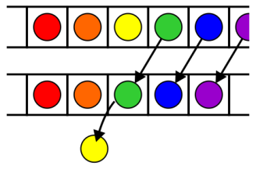
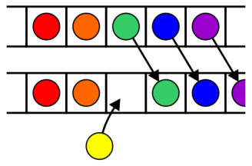
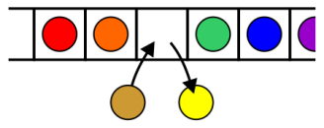
Operations
Operations at the k^{th} entry of the list include:
  Access to the object Erasing an object
  Insertion of a new object Replacement of the object

Slide 6
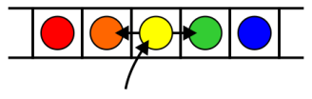
Operations
Given access to the k^{th} object, gain access to either the previous or next object
Given two abstract lists, we may want to
  Concatenate the two lists
  Determine if one is a sub-list of the other

Slide 7
Locations and run times
The most obvious data structures for implementing an abstract list are arrays and linked lists
  We will review the run time operations on these structures
We will consider the amount of time required to perform actions such as finding, inserting new entries before or after, or erasing entries at
  the first location (the front)
  an arbitrary (k^{th}) location
  the last location (the back or n^{th})
The run times will be Θ(1), O(n) or Θ(n)

Slide 8
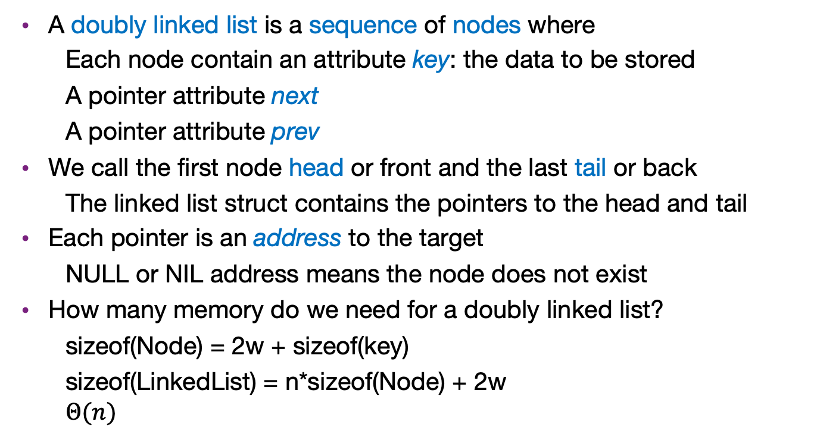
Doubly linked list
A doubly linked list is a sequence of nodes where
  Each node contain an attribute key: the data to be stored
  A pointer attribute next
  A pointer attribute prev
We call the first node head or front and the last tail or back
  The linked list struct contains the pointers to the head and tail
Each pointer is an address to the target
  NULL or NIL address means the node does not exist
How many memory do we need for a doubly linked list?
  sizeof(Node) = 2w + sizeof(key)
  sizeof(LinkedList) = n*sizeof(Node) + 2w
  $$Θ(n)$$

Slide 9
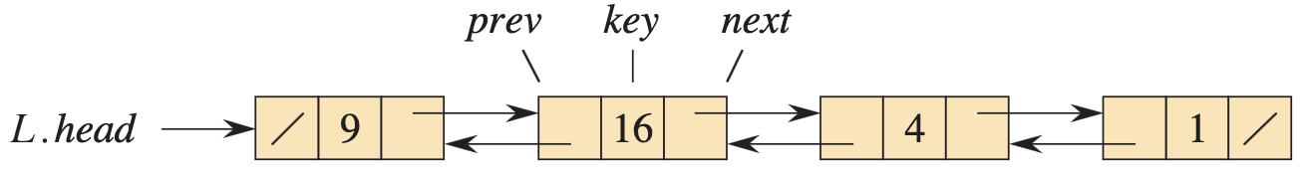
Examples of doubly linked list
List-Prepend(25)
List-insert-after(9, 36)
List-delete(4)

Slide 10
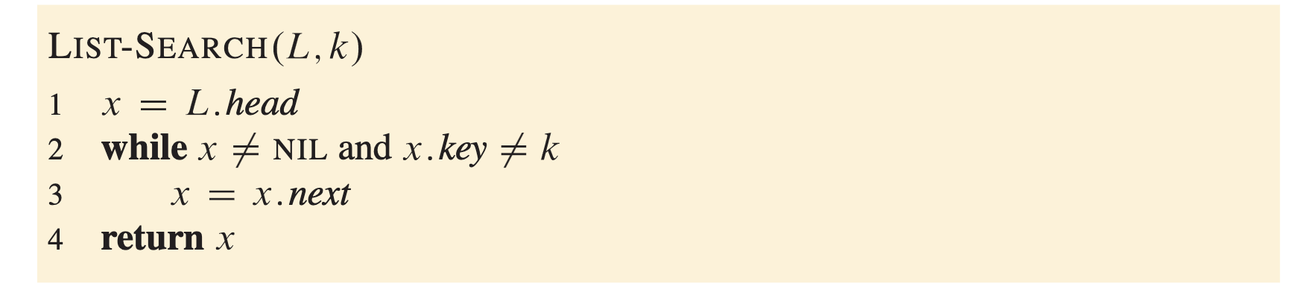

Searching a linked list
LIST-SEARCH(L, k) finds the first element with key k in list L by a simple linear search
  Can we use binary search?
Time complexity $Θ(n)$

Slide 11
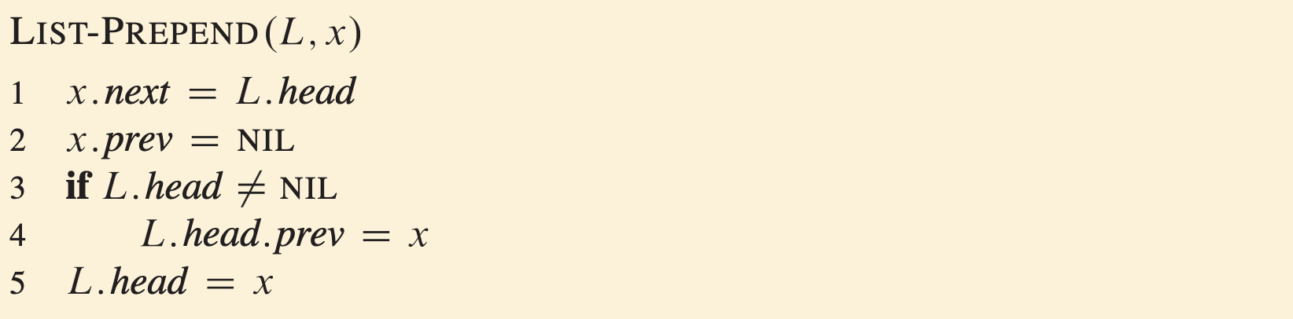

Insert to the front
LIST-PREPEND procedure adds a new node x to the front of the linked list
Time complexity $O(1)$

Slide 12
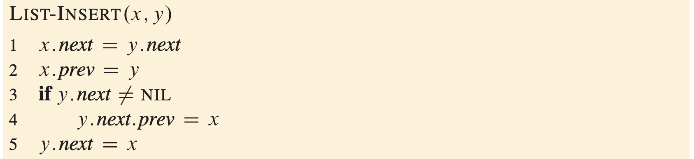
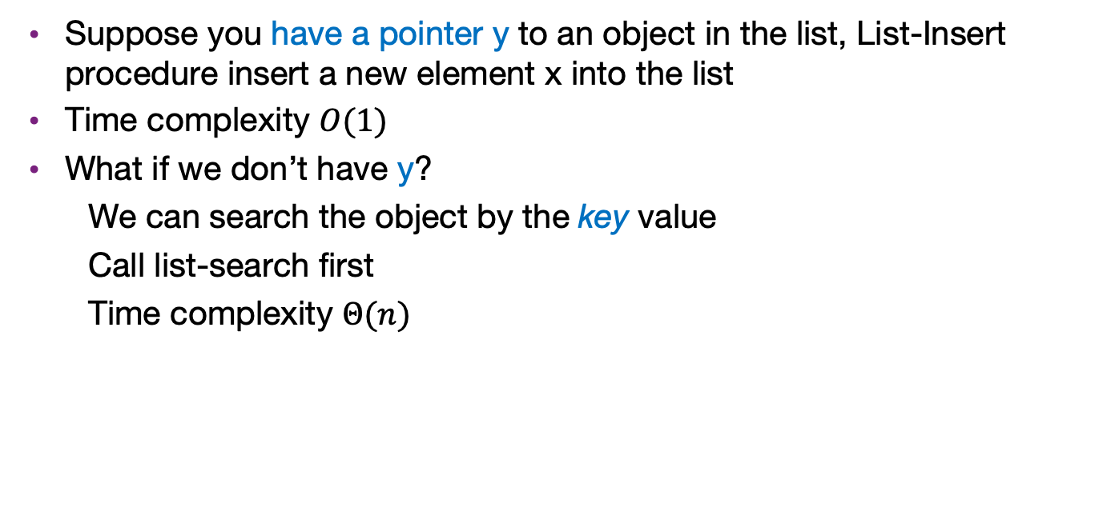
Insertion in general case
Suppose you have a pointer y to an object in the list, List-Insert procedure insert a new element x into the list
Time complexity $O(1)$
What if we don’t have y?
  We can search the object by the key value
  Call list-search first
  Time complexity $Θ(n)$

Slide 13
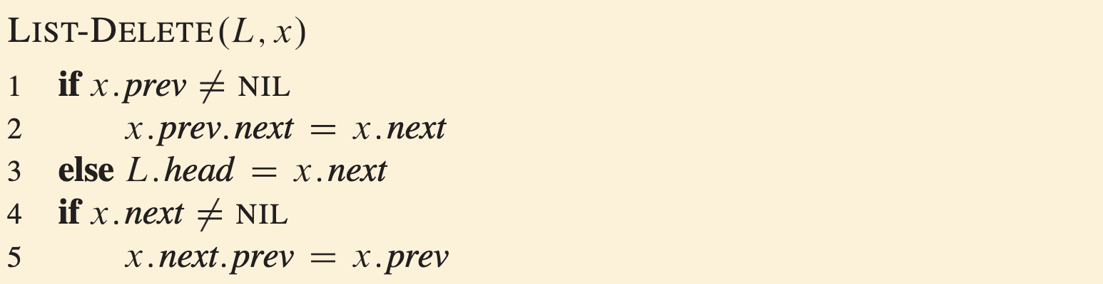

Delete in general case
Suppose you have a pointer x to an object in the list, List-delete procedure delete this element from the list
Time complexity $O(1)$
What if we don’t have x?
  Similar to insertion, we need to search first
  Time complexity $Θ(n)$

Slide 14
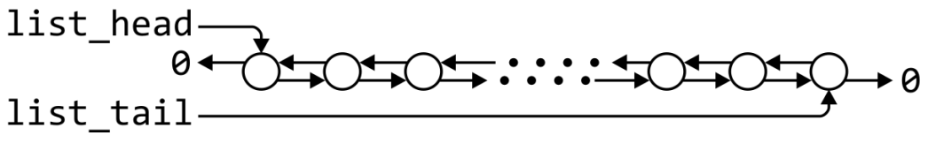
Doubly linked lists
 | Front/1st node | k^{th} node | Back/n^{th} node
Find | Θ(1) | Ο(n)* | Θ(1)
Insert Before | Θ(1) | Θ(1)* | Θ(1)
Insert After | Θ(1) | Θ(1)* | Θ(1)
Replace | Θ(1) | Θ(1)* | Θ(1)
Erase | Θ(1) | Θ(1)* | Θ(1)
Next | Θ(1) | Θ(1)* | n/a
Previous | n/a | Θ(1)* | Θ(1)
* These assume we have already accessed the k^{th} entry—an O(n) operation

Slide 15
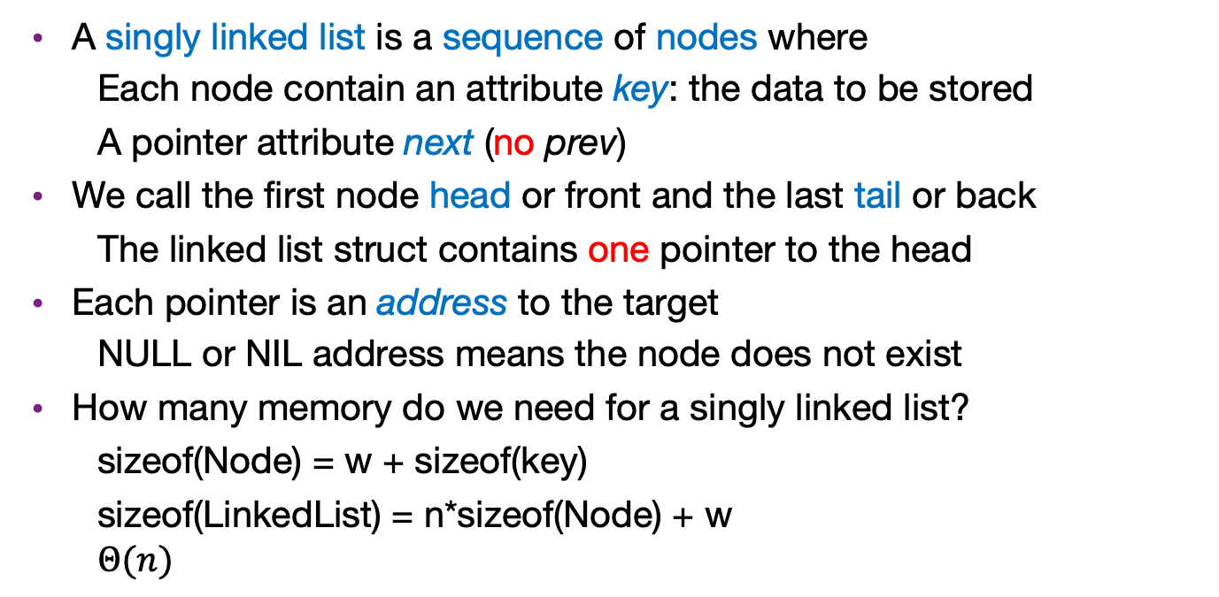
Singly linked list
A singly linked list is a sequence of nodes where
  Each node contain an attribute key: the data to be stored
  A pointer attribute next (no prev)
We call the first node head or front and the last tail or back
  The linked list struct contains one pointer to the head
Each pointer is an address to the target
  NULL or NIL address means the node does not exist
How many memory do we need for a singly linked list?
  sizeof(Node) = w + sizeof(key)
  sizeof(LinkedList) = n*sizeof(Node) + w
  $$Θ(n)$$
Reduce memory by a constant factor

Slide 16
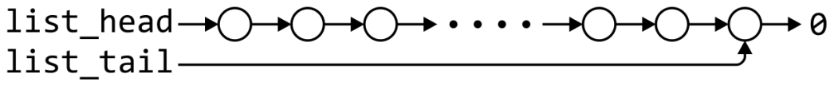
Singly linked list
We don’t have backward access in singly linked list
 | Front/1st node | k^{th} node | Back/n^{th} node
Find | Θ(1) | Ο(n)* | Θ(1)
Insert Before | Θ(1) | Ο(n)* | Θ(n)
Insert After | Θ(1) | Θ(1)* | Θ(1)
Replace | Θ(1) | Θ(1)* | Θ(1)
Erase | Θ(1) | Ο(n)* | Θ(n)
Next | Θ(1) | Θ(1)* | n/a
Previous | n/a | Ο(n)* | Θ(n)
* These assume we have already accessed the k^{th} entry—an O(n) operation

Slide 17
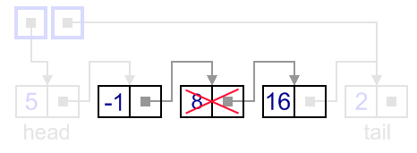
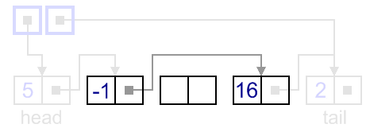

Example: erase/delete an element
We need to update prev and next
Update next is easy
  Current x contains its pointer
How can we update the prev?
  If x is the front, then just need $O\left(1\right)$
  If not, we need to search the node
Time complexity $O(n)$

Slide 18
Singly linked list
 | Front/1st node | k^{th} node | Back/n^{th} node
Find | Θ(1) | Ο(n)* | Θ(1)
Insert Before | Θ(1) | Θ(1)* | Θ(1)
Insert After | Θ(1) | Θ(1)* | Θ(1)
Replace | Θ(1) | Θ(1)* | Θ(1)
Erase | Θ(1) | Θ(1)* | Θ(n)
Next | Θ(1) | Θ(1)* | n/a
Previous | n/a | Ο(n)* | Θ(n)
By replacing the value in the node in question, we can speed things up
– useful for interviews

Slide 19
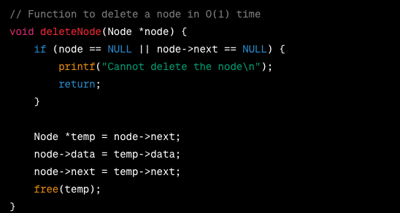
Erase by replacing value
Erase by replacing value
x.key = -1
10
-1
5
10
10
5
10

Slide 20
Use doubly linked list to implement a stack
Recall stack
A stack manages a set S of elements and support two operations:
  push(x): insert a new element x into S
  Pop: remove the most recently inserted element from S and return it
First-In-Last-Out (FILO)
push
pop

Slide 21
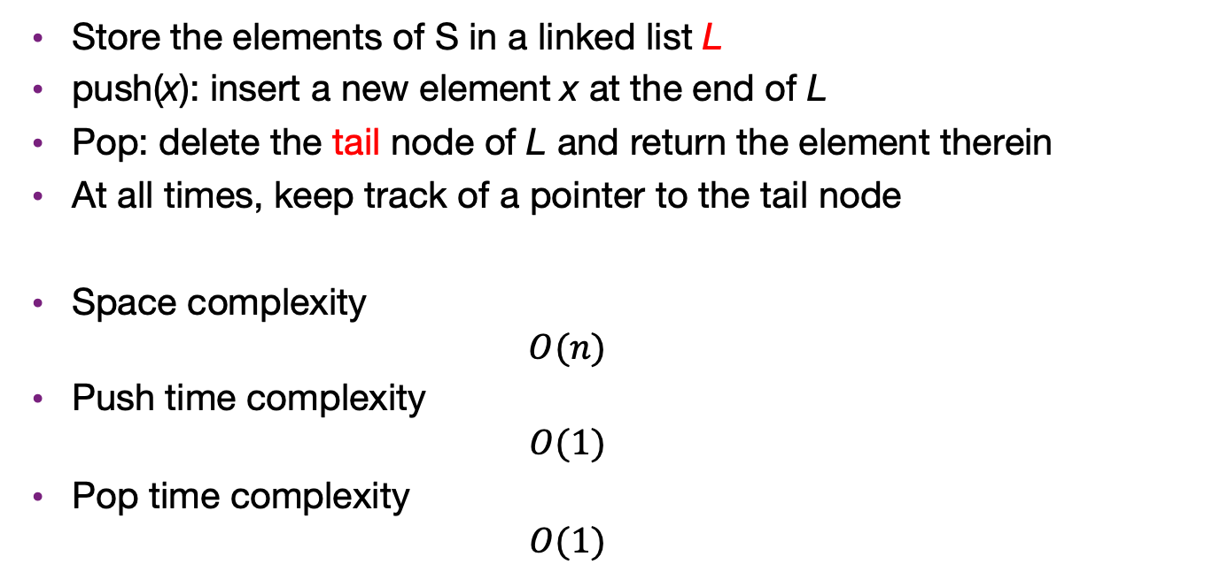
Use doubly linked list to implement a stack
Store the elements of S in a linked list L
push(x): insert a new element x at the end of L
Pop: delete the tail node of L and return the element therein
At all times, keep track of a pointer to the tail node
Space complexity
  $$O(n)$$
Push time complexity
  $$O(1)$$
Pop time complexity
  $$O(1)$$

Slide 22
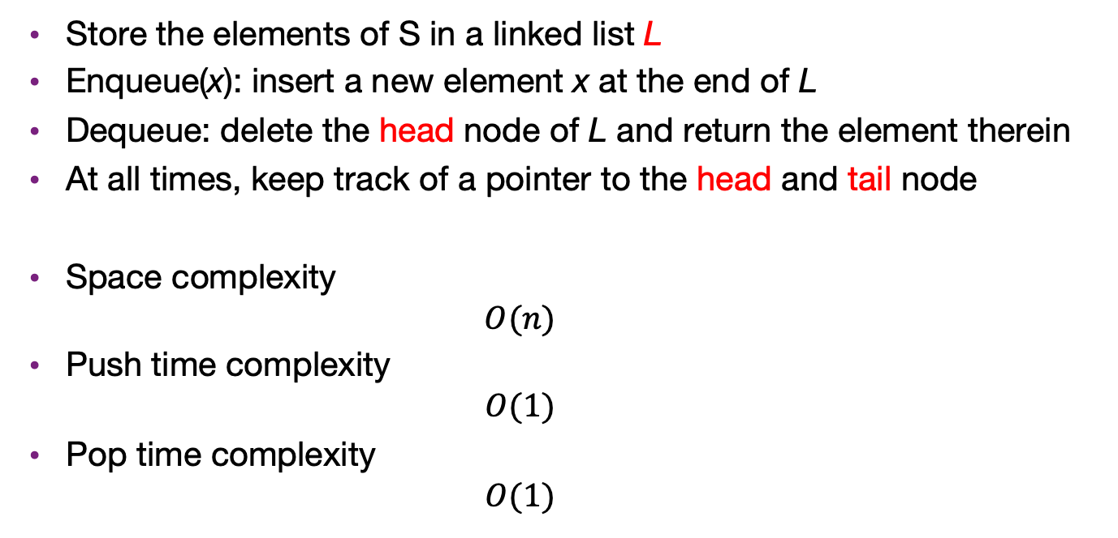
Use doubly linked list to implement a Queue
Store the elements of S in a linked list L
Enqueue(x): insert a new element x at the end of L
Dequeue: delete the head node of L and return the element therein
At all times, keep track of a pointer to the head and tail node
Space complexity
  $$O(n)$$
Push time complexity
  $$O(1)$$
Pop time complexity
  $$O(1)$$

